Slide 1
Digital Image Processing
Image Steganography
Sahil F PES1201701653
Bhuvan M R PES1201701823

Slide 2
What is Steganography?
Steganography refers to the science of “invisible” communication. Unlike cryptography, where the goal is to secure communications from an eavesdropper, steganographic techniques strive to hide the very presence of the message itself from an observer.
Image Steganography combines Image processing and Cryptography techniques.
Data can be present in any form. In this project data is restricted to be present in the form of a TEXT DOCUMENT and an IMAGE.

Slide 3
Encryption of Text in an Image Implementation:
Acquisition of the image and the text.
Split the image into its RGB components.
Convert the text to its binary form.
Similarly convert the pixel values of the individual components to its binary value.
Replace the bits in the image by those from the text.

Slide 4

Original Image

Slide 5

Image after Encryption

Slide 6
In which format the new image should be saved?
JPG is a lossy format while PNG is a lossless format.
JPG is better for photographs while PNG is better for created images.
JPG supports the embedding of EXIF data while PNG does not.
PNG supports transparency while JPG does not
Due to the above mentioned differences between JPEG and PNG formats we conclude that PNG is a better format for the new image to be saved.

Slide 7
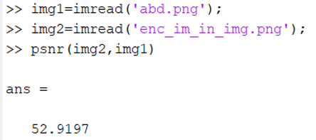
Image Comparison
We compare our images using PSNR values.
Different for JPEG and PNG.

Slide 8
Decryption
In this case the input will be image which contains the required data.
Decryption key is the number of characters.
Acquiring the replaced bits from the image, and combining them will result in the required text.
Write the text in a different file.

Slide 9
Extension
Instead of replacing the last 2 bits of the image pixel, we can set a threshold pixel value based on which number of bits to be replaced will be decided.
We can not only encrypt text in an image, but also encrypt
“An IMAGE in an IMAGE”

Slide 10


Slide 11
Applications
Secure Communication
Transport sensitive data from one point to another such that the transfer of the data is unknown.

Slide 12
THANK YOU

